Slide 1
Food Delivery From Restaurants
Consumer’s Orders delivery planning
Optimization of delivery route

Slide 2
Introduction
In recent times the restaurant's food delivery model has changed drastically. The online ordering facility offered more options and convenience, so more and more consumers are opting for the online ordering. This has affected the operations of the restaurants and has given different new challenges to the restaurant owners. Now it is hardly possible for restaurant owner alone to handle the orders and also to provide the logistics, to deliver the consumers demand.so they are outsourcing the delivery activities to third party.
In traditional online delivery system, The online platform simply take orders from consumers and route them to restaurants which handle the delivery themselves. In contrast, recently new-delivery players build their own logistics networks, providing delivery for restaurants that don’t have their own drivers. In this new delivery system there are many challenges we can think of, examples are as below.
Consumer’s Orders delivery planning :
Orders consolidation
Orders clustering based on the restaurant and consumer locations
Transportation fleet management :
Fleet optimization
Route optimization
What if scenario running for business strategies and Others
Business scenario validations
Drivers management etc.

Slide 3
Business Problem
Consumer’s Orders delivery planning :
Orders clustering based on the restaurant and consumer locations After consolidating the orders from different online portals for the different restaurants, the orders needs to be clustered so that they can be assigned to the drivers/bike riders taking into consideration the vehicle carrying capacity, time required to deliver the food item, locations of the restaurants and consumers. The scope this project will be restricted to the clustering based on the locations only.
Route Optimization : As the service provides will have more number of restaurants( source) and consumer(destinations) locations, to meet the demand of the consumer the traveling path needs to be optimized in real time to keep the delivery trasportation cost as low as possible.

Slide 4
Consumer’s Orders delivery planning – Orders clustering based on the restaurant and consumer locations
Steps and Assumptions
select the city /radius of supply – Define the scope of the business
Prepare the list of restaurants in that area
Plot the restaurants on map to get the visual confirmation
Decide on the number of clusters to be formed with k-mean algorithm to minimise the error/sum square distance for best number of clusters.
Cluster the restaurants ,based on location of the restaurants, and identify the smallest units of supply locations and assign this unit to a driver to complete the delivery.
Add customers, assuming each restaurant serve one customers and all the customers are within the smallest unit of supply identified in step 5.
Note : In step 6 we assumed to pick the customer location within the restaurant cluster formed in step5, this is for simplifying the problem. We can think of other possibilities like swapping orders between drivers , the customer location in far place from the ordered restaurants ,shelf life of the food and many more complexities, which are not discussed here.

Slide 5
Route Optimization
Steps and Assumptions
The consumer locations are dummy for this project , This information could be taken from the online platform for the different restaurants while implementing in the real time scenarios.
The restaurant locations are taken from the Foursqare API , depending on the scope of the delivery of the logistics provider company
unlimited vehicle carrying capacity is assumed for route optimization.
Euclidian distances are considered for the calculations, this problem can be enhanced by taking the driving distances also.
Consumer order delivery time windows are assumed to be at any hour of the day
Shelf life of the food material is not taken into account for this project.
Simulated Annealing (SA) algorithm is used to calculated the optimal delivery route to the consumers from restaurants similar to traveling salesman problem (TSP)
The SA algorithm is called iteratively to include the consumer in the route optimization only after the corresponding consumer’s restaurant is visited

Slide 6
Example Use Case
In the following slides, solutions to the problem are discussed in details with an example
Here I have used the “New York City, NY” (40.7127281, -74.0060152) as the location for opening the freight provider business.
The above location (40.7127281, -74.0060152) is assumed to be the location of the freight providers office location.
The scope of delivery is assumed to be within the 1000m radius, and all the venues with the description “Restaurant” in category are considered for the order delivery.

Slide 7
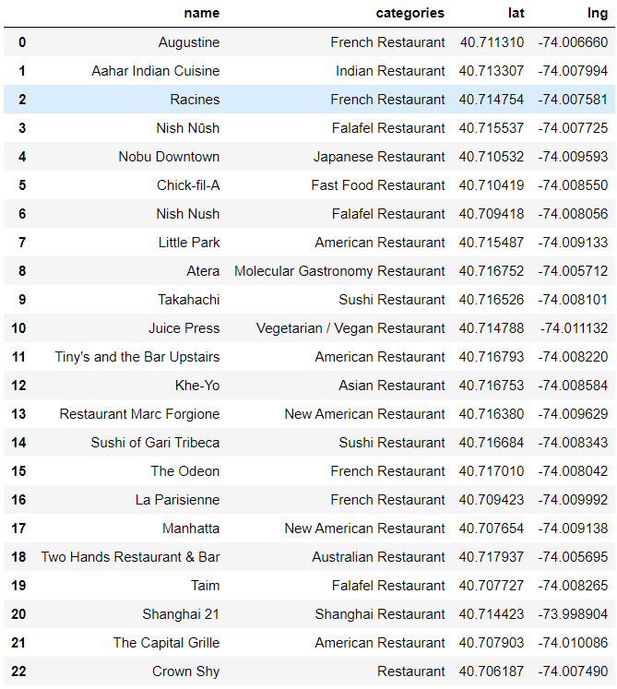
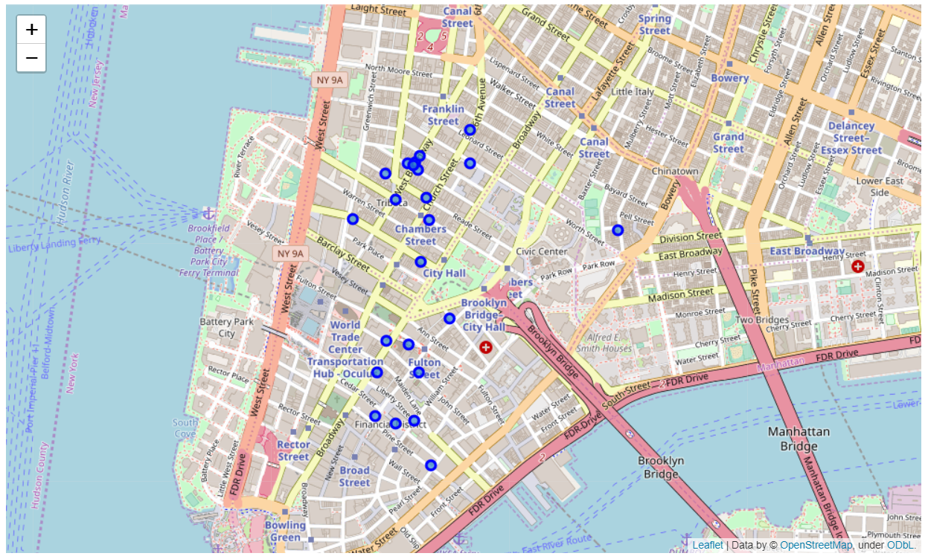
Getting the Restaurants information from the Foursqaure API
Define Foursquare.com Credential and versions
Preparing the URL to fetch the venues from the Foursquare.com
Get the results and clean the data received and plot on the folium map for review.
Found 23 restaurants within the scope mentioned, Location shown with the blue circles.

Slide 8
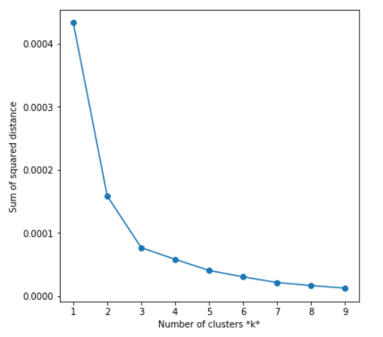
Orders delivery Planning – 1, Clustering the restaurants for delivery, based on their locations
a.Evaluate the number of clusters to be formed
Unsupervised K- mean clustering is used for the orders/restaurants clustering
To find the appropriate number of clusters which reduce the sum of square distance thus distinct clean clusters. I am using here the elbow method to finalize this.
By seeing the graph of the sum of squared distance Vs number of clusters , we can fairly choose cluster numbers to 5

Slide 9
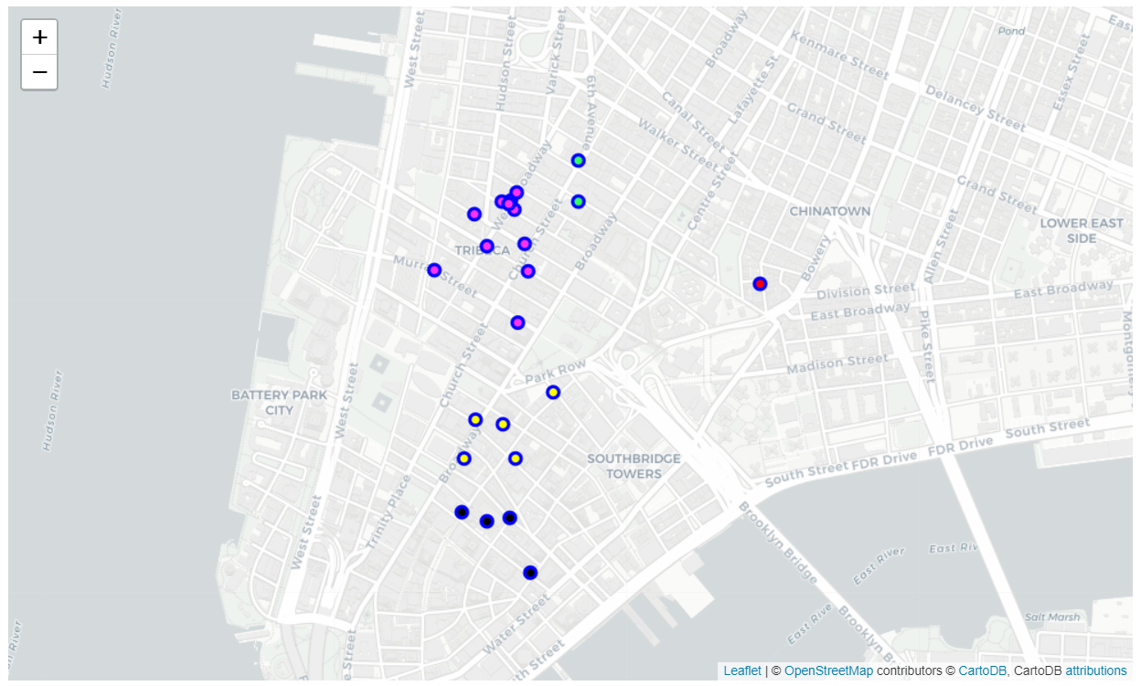
Orders delivery Planning – 1, Clustering the restaurants for delivery, based on their locations
b. Create 5 clusters with K-mean algorithm
Make use of sklearn package to come up with the clusters, and plot them on the map
After visual inspection and review , we can assign these restaurant to different drivers.
4
0
3
1
2

Slide 10
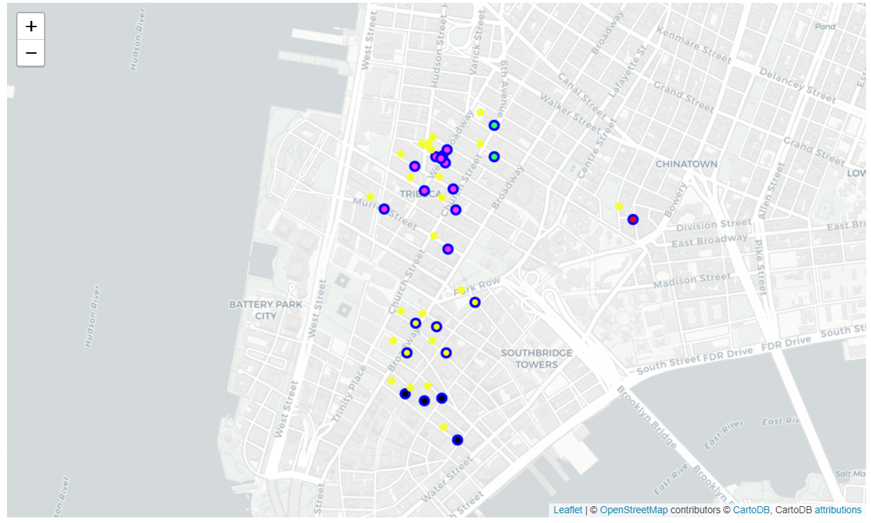
Orders delivery Planning – 2, Identifying the customers locations for the restaurants
The Customers locations for the above created restaurant clusters can be obtained dynamically from the restaurant online portals.
Here in this project, random nearby location is considered as the customer location, in actual implementation we have to get this information from the online restaurant portal.
For simplicity the customer locations are chosen such that the location of the customers fall within the cluster zone as shown in yellow circle below and assumed only one customer for each restaurant..

Slide 11
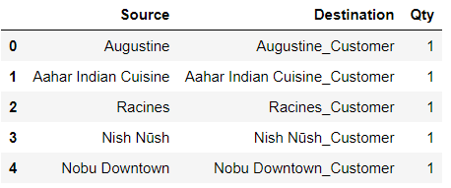
Orders delivery Planning – 3, Orders consolidations of the restaurants
To simplify the problem I have considered a Single order from all the customers from their corresponding restaurant is assumed. i.e. no two restaurants serving single consumers demand and no two consumers are ordering from the same restaurant
Sample order data frame is as below:

Slide 12
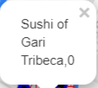
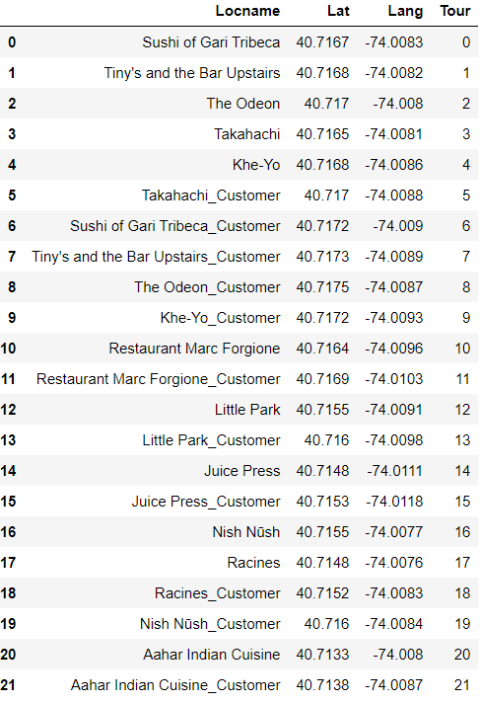
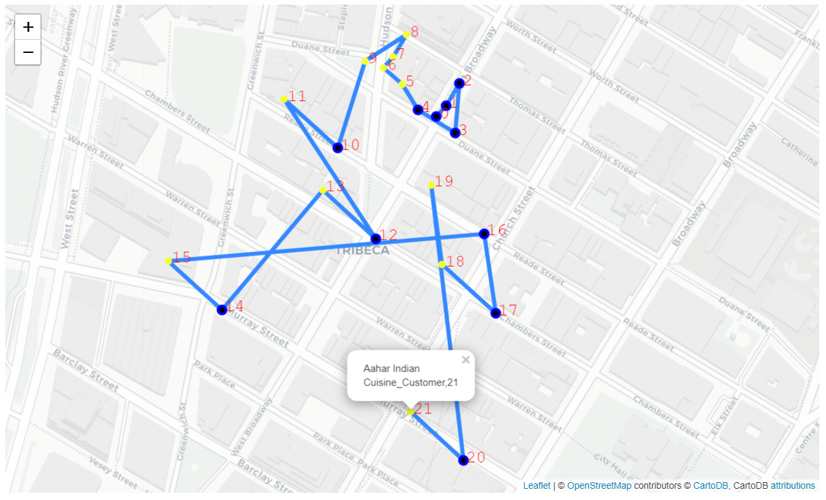
Optimization of delivery routes
Once the orders, locations, cluster assignments are finalised , we can use simulated annealing algorithm to evaluate the optimal route similar to famous traveling salesman problem(TSP).
Here is the example of the optimized routing path for the cluster #0
The route optimization is done such a way that the consumer is visited only after picking the order from their corresponding restaurant.
Below is the example of the sequence of visit to restaurants and consumers for optimal delivery in cluster #0, it is starting from Sushi restaurant to Aahar Indian restaurant customer.
Freight provider office

Slide 13
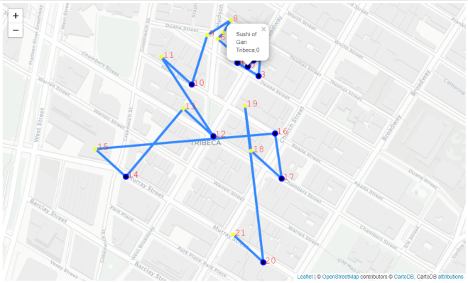
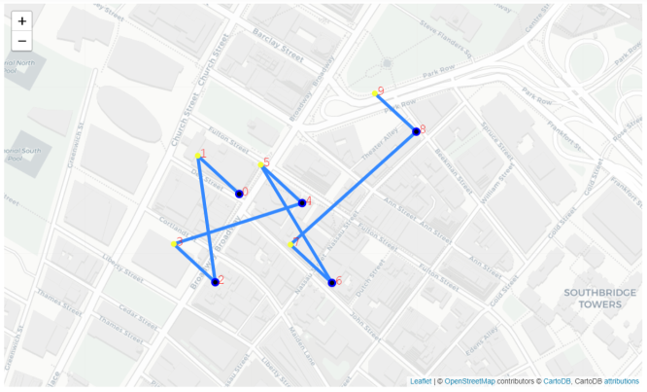
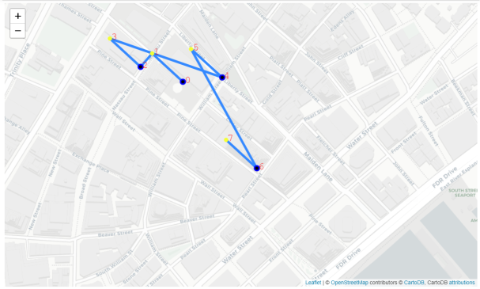
All Other Routes
Cluster -0
Cluster -1
Cluster -2
Note : Cluster 3 and 4 are having less than 2 customers so not optimized as it is obvious to visit these restaurants

